Slide 1
IT8701-Intro to Programming for Data Science Data Analysis Project
Prepared by:
Kwan Han Yang
Chen Wanchuan
Mohamad Rahmat
Xiao Changhua

Slide 2
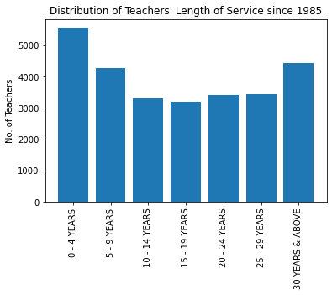
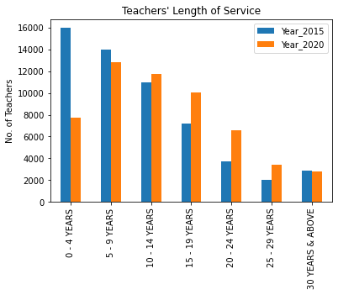
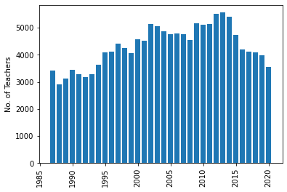
Teachers Length of Service
The total number of teachers increases from 1985 to 2015 but decrease from 2015 to 2020.
Significant drop in new hires between 2015 and 2020.
Teachers attrition rate decreases. Teachers stay longer. Higher number of experienced teachers in 2020.
Teachers tend to retire before 30-year mark.

Slide 3
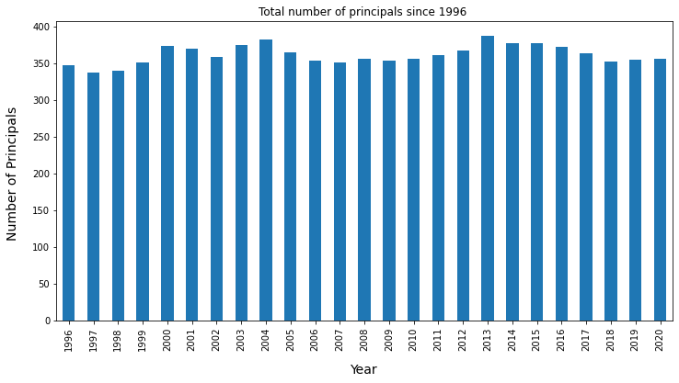
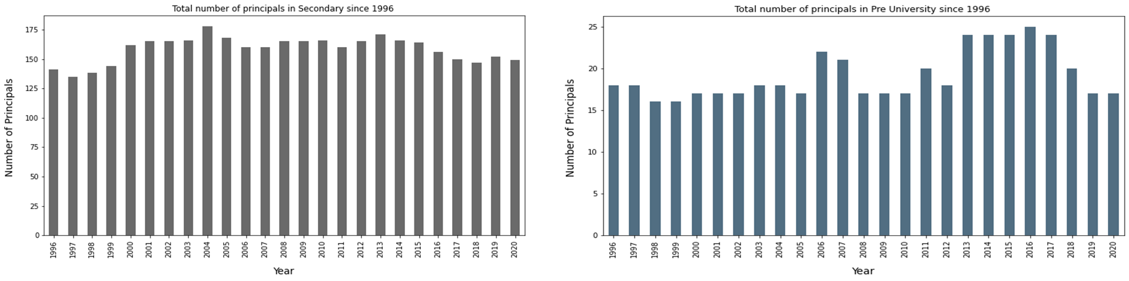
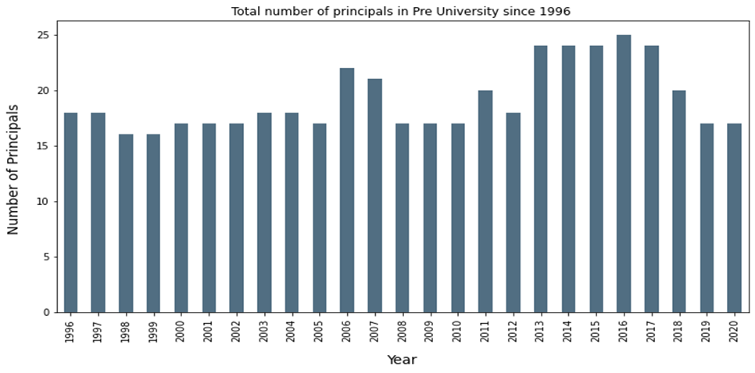
Number of Principals
The total number of principals from Primary, Secondary and Pre-University since 1996 remains constant, as total number of schools remains constant.
The total number of Secondary principal since 1996 is constant
As for Pre-University, there is a slight surge from 2013 which might be due to new appointed principals or principals from other levels because there is no significant changes in the overall total number of principals.
There is a decrease in the numbers of principals in Pre-University after 2018 which might be due the decrease in number of Pre-universities due to mergers. (Straits Times, 2018)

Slide 4
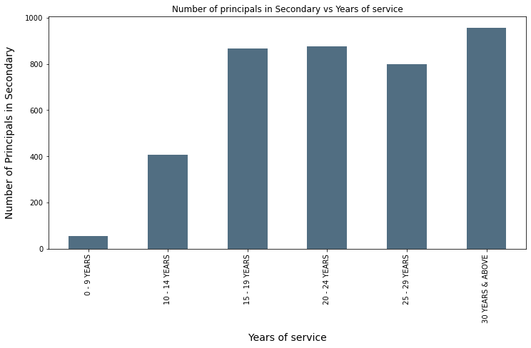
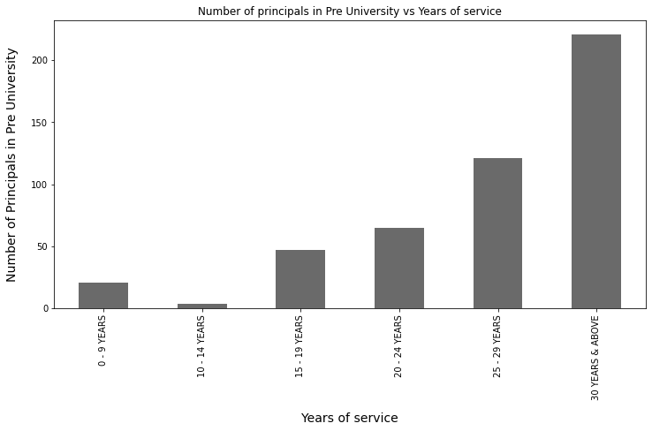
Principal Length of Service
Most principals choose to retire or transfer to other levels during year 15-19 for Secondary schools.
Significant number of principals in Pre-University only leave their service after 30 years.

Slide 5
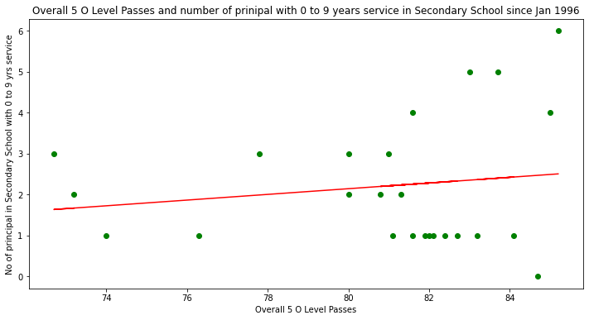
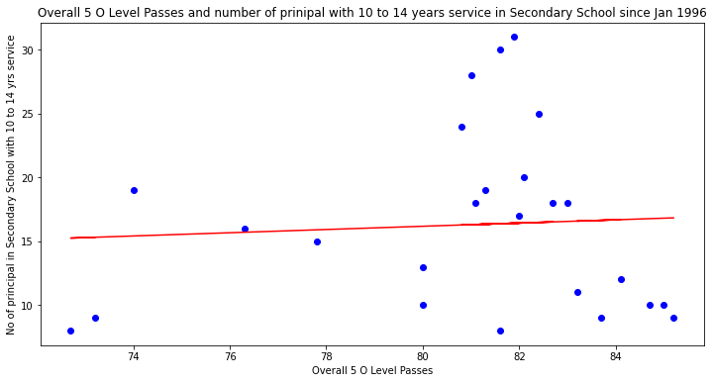
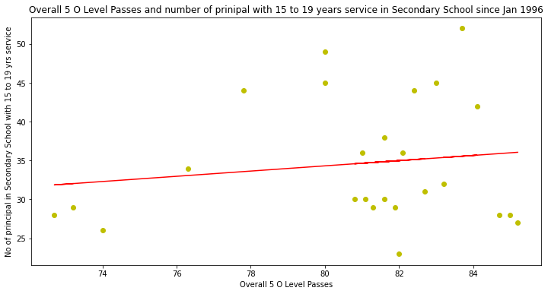
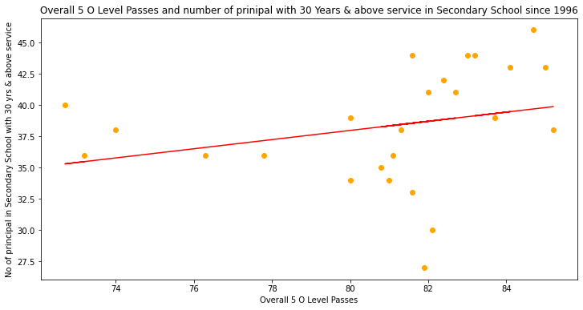
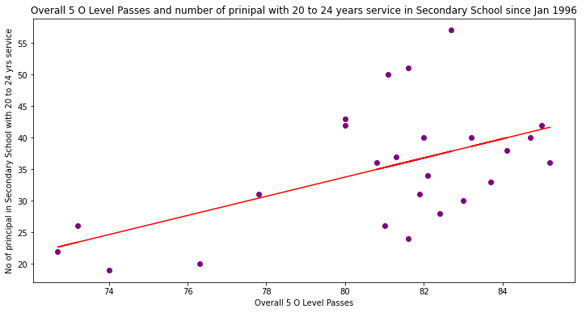
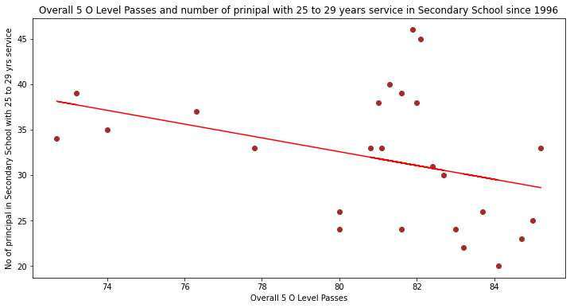
Correlation between Principals’ Length of Service and O Level results
Most of the scatterplot graph points are scattered in random direction or a few graphs having a very weak correlation.
No correlation between principals’ length of service and O Level results.

Slide 6
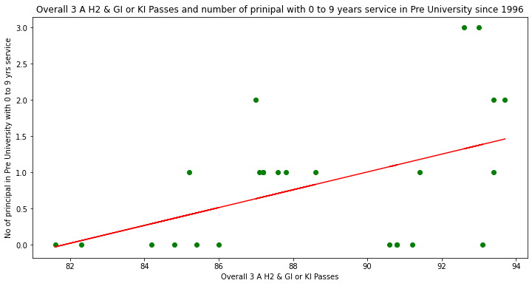
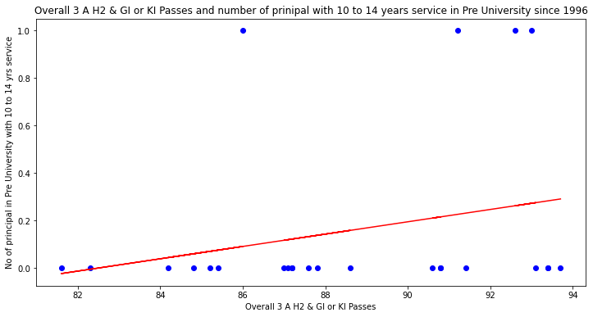
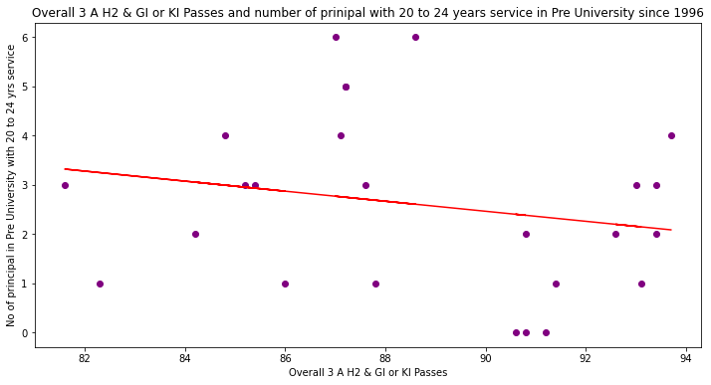
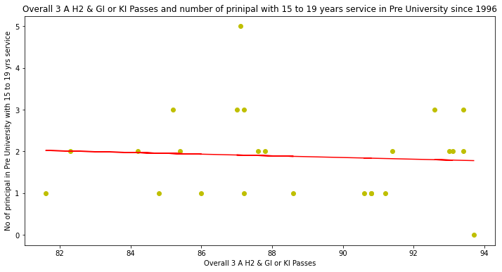
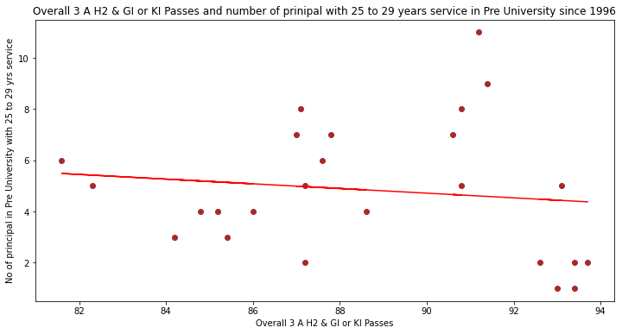
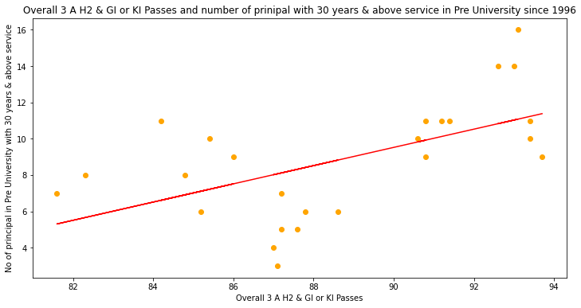
Correlation between Principals’ Length of Service and A Level results
Most of the scatterplot graph points are scattered in random direction or a few graphs having a very weak correlation.
No correlation between principals’ length of service and A Level results.

Slide 7
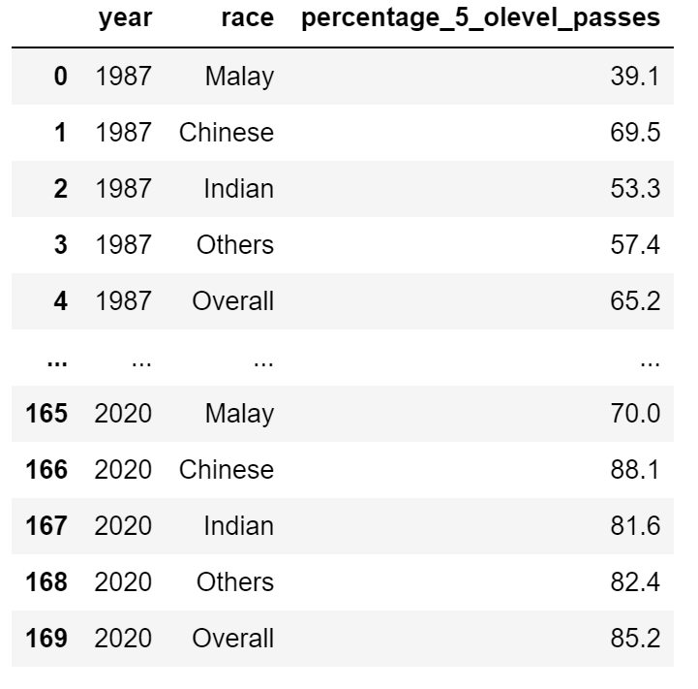
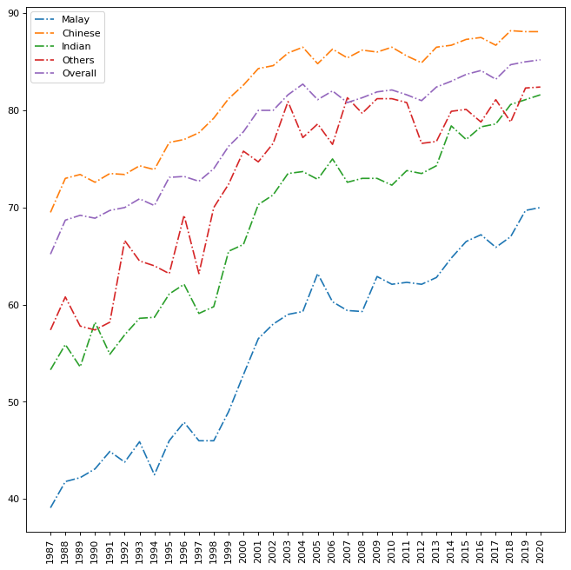
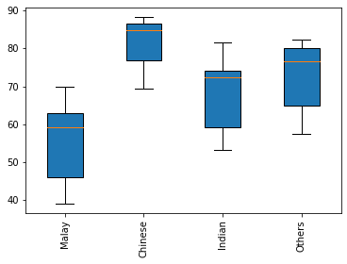
Correlation between Race of students and O Level Results
O Level passing percentage increases over the years for all races
Chinese students perform the best among the 4 races , with the passing rate consistently above the Overall average
Malay students perform the worst among the 4 races, with the passing rate consistently below the Overall average
Malay students have the bigger variation in passing rate while Chinese students have the smallest variation over the years.

Slide 8
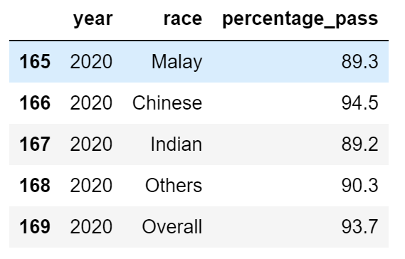
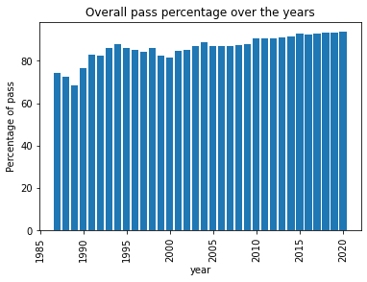
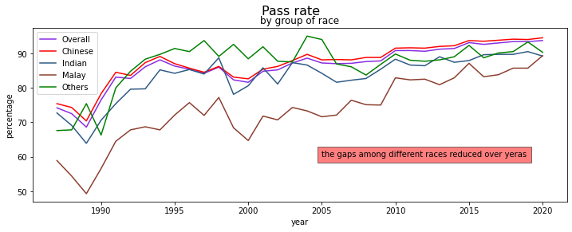
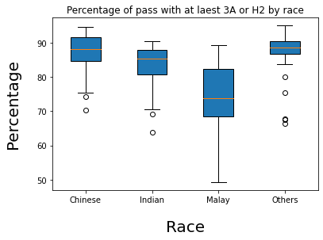
Correlation between Race of students and A Level Results
A Level passing percentage increases slightly over the years for all races
Chinese students perform the best among the 4 races , with the passing rate slightly above the Overall average
Malay students perform the worst among the 4 races, with the passing rate consistently below the Overall average
Differences in the passing rate among the different races narrowed over the years.
Malay students have the bigger variation in passing rate while Chinese students have the smallest variation over the years

Slide 9
Conclusion
Number of teachers fluctuate while number of principals remain constant.
Changes in teachers’ length of service distribution over the years.
Principals’ Length of Service has no correlation on the students performance in national exams for O Levels and A Levels
Race is a key factor in the students performance: Chinese students perform better, Malay students perform worse
Passing rate for both O Levels and A Levels increases over the years
Malay students performance at both O Levels and A Levels have improved the most among the 4 races, but still being the lowest
Difference in passing rate for A Level between different races has narrowed more than that for O Level.

